Slide 1
4.5 → 4.2
-0.3pp
Marketplace Service Performance
Buyer CSAT
7% → 12%
+71.43%
Last 3 Months (Oct 2025 - Dec 2025)
Late Delivery Rate
Prepared by Stella Akindolie
3% → 6%
+100%
Refund rate

Slide 2
What We'll Cover Today
01
Service Performance
Marketplace services performance
02
Insights
Factors driving performance decline
03
Next Steps
Recommendations on actions to take

Slide 3
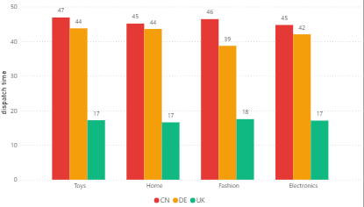
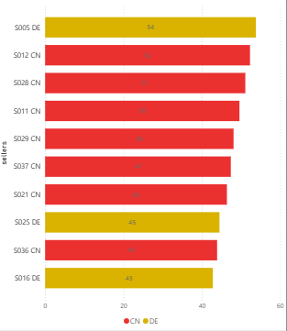
Late Deliveries Are a Seller-Origin Problem .
Country
Late Rate
64.7%
58.7%
8.2%
CN Late Rate
DE Late Rate
UK Late Rate
Average dispatch time (hrs) by category and country
Top 10 sellers dispatching late
UK late rate
Late deliveries are caused by the dispatch time. CN and DE sellers take 39-47 hours before shipping an order while UK sellers average 16-19 hours.
The issue of late deliveries and long dispatch hours occurs across every product category for CN/DE especially with DE Fashion (87.5% late) and CN Electronics (75% late)
S005, S012, S0028, S011, S029 all exceed 70% late rates and are among the top 5 sellers dispatching late taking 48-57 hours to dispatch

Slide 4
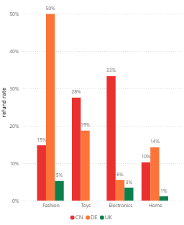
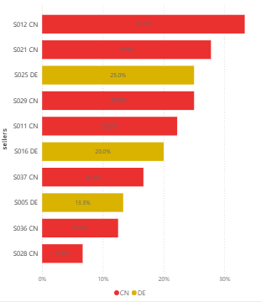
Refunds are directly caused by late deliveries
30.7%
8%
60%
of late orders end in a refund
of quality issue tickets end in a refund
CN/DE are late on over 60% of their orders
Refund rate by country and category
Top 10 sellers with high refund rates
Late delivery is a significant contributor to refunds. 30.7% of all late orders end in a refund and not a single on-time order was refunded.
The same seller cohort is driving refunds. CN sellers refund 20.2% of orders, DE sellers 17.5%, UK sellers 2.5%.
From the category level, Fashion (10.8%) and Toys (9.6%) carry the highest refund rates with DE Fashion taking a 50% refund rate and CN Electronics sits at 33.3%.
S012 (CN), S0021 (CN), S025 (DE), S029 (CN), and S011 (CN) account for most of the refunds requested by customers.
Wightlink leads on impression share at 38.05%. Our 89.84% top-of-page rate and 50.62% abs. top-of-page rate are strong across all campaign types.
directferries.co.uk and redfunnel.co.uk each appear in around 45–49% of our auctions. Despite this, our position above rate is competitive
openferry.com has established a foothold at 14.74% impression share with 28.6% overlap, they are emerging as a third direct ferry competitor worth tracking into FY 2026/27.
booking.com, awayresorts.co.uk, and parkdeanresorts.co.uk all remain below 10% impression share, they are present but represent limited competitive pressure at a campaign-wide level.

Slide 5
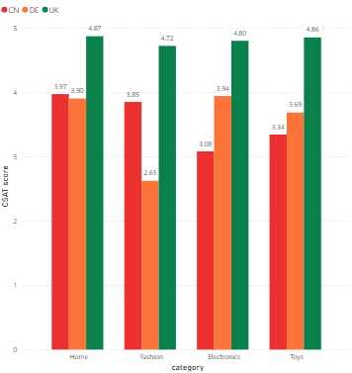
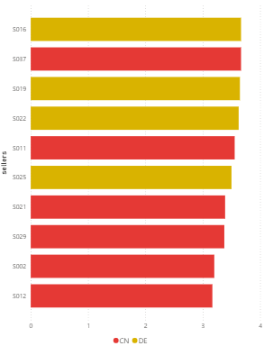
Late Deliveries & Refunds request are affecting CSAT score .
5.0
2.81
1.60
Ontime orders
Late orders
Refunded orders
CSAT by country and category
Top 10 sellers with low CSAT
Late delivery is the strongest factor affecting CSAT score and causing it to decline. On-time orders score a perfect 5.0 CSAT. Late orders score 2.81. This shows customers reviews/rating are largely driven by the kind of service they receive.
Refunds are also contributing to CSAT decline. When a buyer receives late orders, they request for refunds which decreases CSAT scores further. Refunded orders score 1.60 CSAT on average
CN and DE sellers have the Lowest CSAT scores with S019, S025, S029 appearing among the top.
UK Pro sellers outperform Standard sellers, but CN Pro sellers are actually performing worse than CN Standard sellers on late rate (68.9% vs 62.2%).

Slide 6
Next Steps
Seller
Buyer (customers)
Implement stricter late dispatch metrics - we should consider enforcing a 24-hour dispatch time cap for sellers and penalties for consistent failure like reduced visibility or listing suspension.
Encourage exchange over refunds for customers or the option to keep in the platform for future purposes
Consider introducing a compensation for late deliveries e.g. discount on next orders
Review the Pro tier criteria and introduce stricter requirements for sellers to meet to earn the badge. This could also include stricter vendor screening.
Alert buyers automatically when an order is running late before they raise a ticket. This would help reduce complaint volume and show platform accountability.
Introduce tiered delivery options that meets the customers expectations and allow sellers to set realistic delivery windows within the marketplace windows. e.g. standard 3 to 5 days or premium next day.
Consistently encourage prepackaging items among sellers to speed up dispatch time and introduce category-level quality standards for Fashion and Toys

Slide 7
Any Questions?

